Slide 1
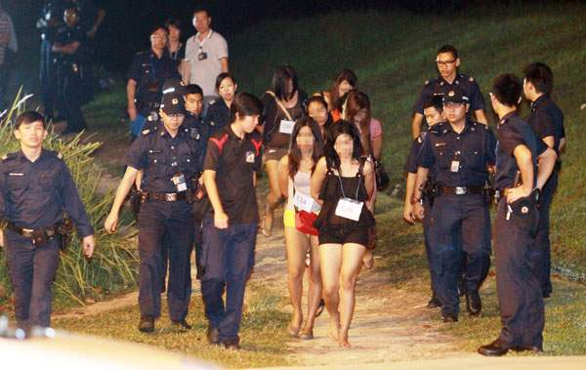
Raids on brothels in Singapore

Slide 2
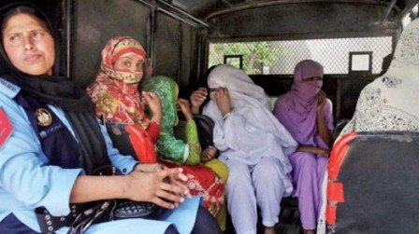
Raids in Pakistan

Slide 3
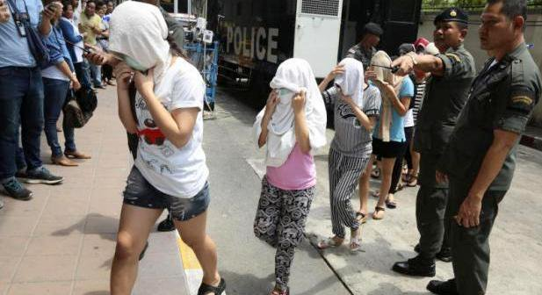
Raids in Bangkok

Slide 4
Raids in China

Slide 5
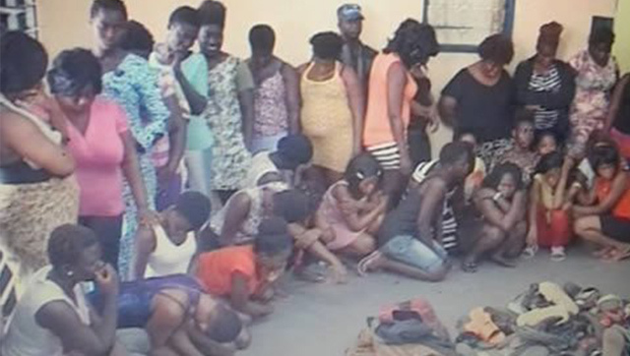
Raids in Ghana

Slide 6
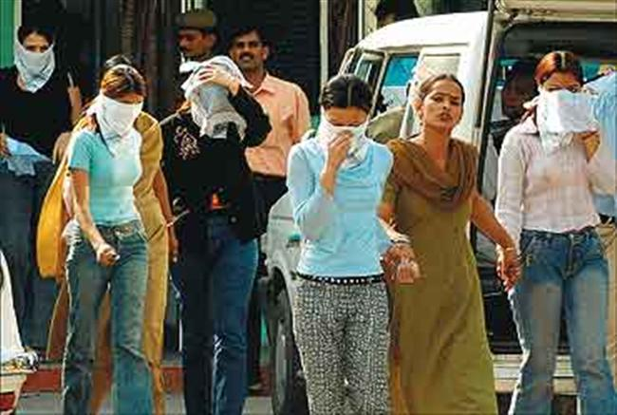
Raids in Hyderabad, India

Slide 7
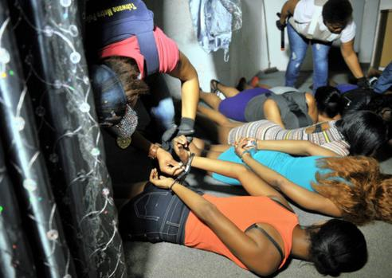
Raids in South Africa

Slide 8
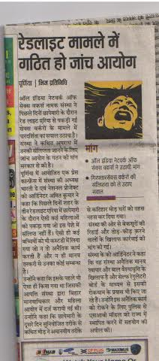
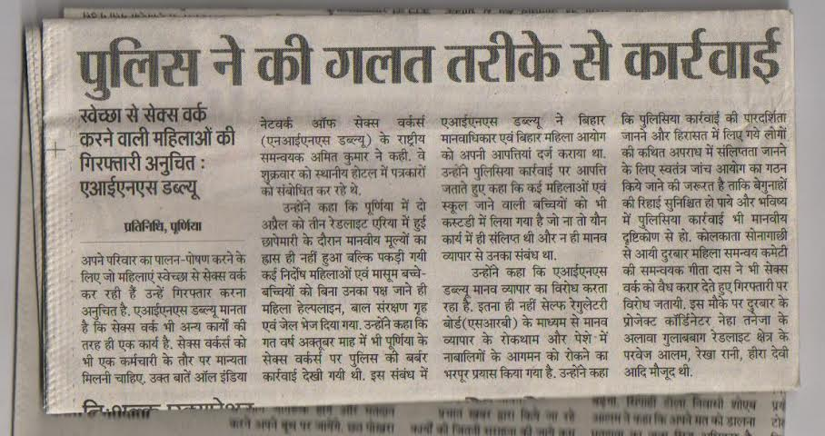
Raid in Purnia, Bihar

Slide 9
Maharashtra
Uttar Pradesh
Number of visible SWs has drastically reduced. Pressure of local merchants & police raids have forced SWs to migrate. Records of SWs’ houses being locked with their children inside have surfaced.
Frequent raids and girls taken away on excuses of ‘rescue’. In Ahmednagar District, Gairayi and Cage red light area- oldest professional place for sex workers was raided & abolished by the police.
Raids & Atrocities in India
Gujarat
Bihar
Under rehabilitation policies, more than 500 sex workers moved to Aaji Dam slum area. But police during the raid locked the houses & threw the SWs out of the house
Muzaffarpur, a bustling city & once a dense populations of SWs is now on the decline. Police raids routinely culminate in SWs & their families being booked for false cases.

